Slide 1
Chapter 14
Organizational Documents and Policies

Slide 2
Plans and Procedures
Change Management
Incident Response Plan
Disaster Recovery Plan
Business Continuity Plan
System Life Cycle
Standard Operating Procedure
Notes:
Change Management: Formal process of how changes are made in an organization or company
Document the reason for the change
Put in a change request
Exact steps required to implement the change
A rollback process if it all fails
A list of departments of people that it will impact
Notify all potentially impacted individuals
Approval process
Maintenance window is the amount of time a system will be down
BCP: is a plan to keep business operational in the even that it needs to recover from a disaster
System Life Cycle: managing asset disposal
Standard Operating Procedures: the business objectives or how to handle different issues

Slide 3
Common Agreements
Non-disclosure agreement (NDA)
Service-level agreement (SLA)
Memorandum of Understanding (MOU)
Notes:
NDA: agreement between two parties that defines what information is considered confidential and cannot be shared outside the two parties
SLA: an agreement that defines the allowable time in which a party must respond to issues on behalf of the other party
MOU: Both sides agree on the contents, it’s an informal letter of intent, not a contract

Slide 4
Hardening and security policies
Acceptable Use Policy
Password Policy
BYOD Policy
Remote Access Policy
Onboarding/Offboarding Policy
Security Policy
Data Loss Prevention
Notes:
Acceptable Use Policy: Outlines every action that is allowed in addition to those that aren’t allowed using company assets or on the company’s network
Password Policy: defines the requirements for all passwords, including length, complexity, and age
BYOD policy: Implement control over personal devices to protect the safety of your network and data
Remote Access Policy: define requirements for all remote access connections to the network; VPNs, specific internet speeds, wired vs wireless methods, etc
Onboarding/Offboarding policy: documentation, training, and equipment inventory when adding an individual to your company or firing an individual
Security Policy: Documentation of IT security; Notification bulletins, emails, documentation to inform users and staff on the standards
Data Loss Prevention: designed to look for sensitive data and block it from leaving the network, define policies around how sensitive data is to be transferred outside the network like adding encryption

Slide 5
Schematics and Diagrams
Schematics and diagrams can be simple sketches created while brainstorming or troubleshooting on the fly; or they can be highly detailed, refined illustrations created with some of the flashy software packages available today.
Fall into these three groups:
Wiring diagrams/schematics
Physical network diagrams
Logical network diagrams

Slide 6
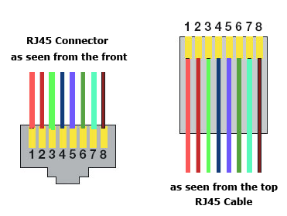
Wiring schematics
Made up of cabled and other physical media: coax, fiber, and twisted pair.
RJ45 Connector
For example, in an RJ45 connector, pin 1 is on the left and pin 8 is on the right, so clearly, within your UTP cable, make sure the right wires get to the right pins.

Slide 7




Physical Network Diagram
Physical Network Diagrams
A physical network diagram contains all the physical devices and connectivity paths on your network and should accurately picture how your network physically fits together in detail.
Avoiding Confusion
Come up with systems for naming devices and numbering connections that are intuitive
Router
Internet
Switch 1
Switch 2
Server 1
(Login)
Server 2
(Files)
Server 3
(Mail)
19
workstations
2 Printers
Notes:
Follows the physical wires and devices, shows the flow of data

Slide 8
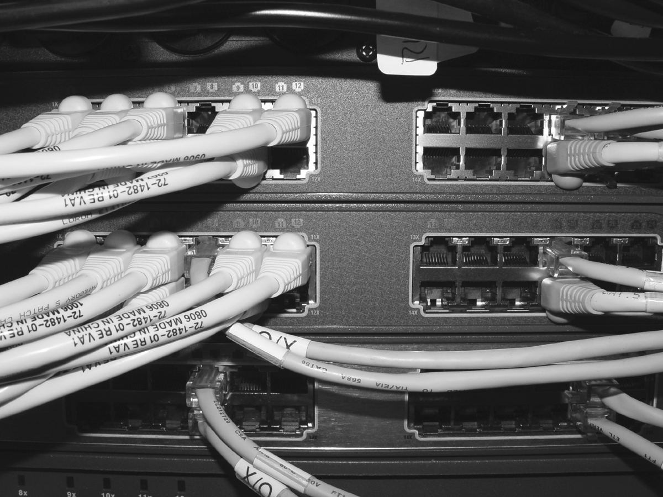
Schematics and Diagrams
All wires have to plug in somewhere.
It’s really good to know where that is.
Whether it’s into a hub, a switch, a router, a workstation, or the wall, you positively need to know the who, what, where, when, and how of the way the wiring is attached.

Slide 9



Detailed-Physical Diagram
A more detailed physical network diagram is necessary in many cases.
Internet
Clients

Slide 10




Physical diagram
Detailed physical network diagrams are necessary even down to rack space.
Cisco 2960 XL Switch
8U Rack Mount
Monitor
PC-1
PC-2
PC-3
PC-4
PC-5
Rack Diagram
Router 55.800.50.1
PC-6
VLAN1 Netware 5.1
55.811.50.20
Cisco 2900 XL Switch
Cisco 2900 XL Switch
VLAN1 RedHat 7.1
55.812.50.20
PC-7
UPS
PC-8
PC-9
UPS

Slide 11

Logical Network diagram
A logical network diagram includes protocols, configurations, addressing schemes, access lists, firewalls, types of applications, etc. that apply logically to your network.
Firewall
External Router
Internal Router
Internet
R&D subnet
192.168.5.0/24
File Server IP:
192.168.5.10/24
Printer IPs:
192.168.5.20/24-
192.168.5.39
Workstation IPs:
192.168.5.50/24-
192.168.5.99
Web Server
www.example.com
192.168.3.10/24
Mail Server
mail.example.com
192.168.3.15/24
Admin subnet
192.168.6.0/24
File Server IP:
192.168.6.10/24
Printer IPs:
192.168.6.20/24-
192.168.6.39
Workstation IPs:
192.168.6.50/24-
192.168.6.99
Server subnet
192.168.4.0/24
Server IPs:
192.168.4.10/24
192.168.4.11/24
192.168.4.12/24
192.168.4.13/24
Notes:
Logical diagram includes protocols, configurations, addressing schemes, access lists, firewalls, etc

